Slide 1

“Carving your ideas to reality”

Slide 2
About Us
MT Innovation provides customized construction and interior. It has been a decade since we are crafting and innovating the wood crafts. Nowadays, wooden interior is not just about chairs and tables; it has gone much beyond.
Over the years, we have gained the experience and have delivered the work for some of the big names in different fields of Hospitality, Commercial, Institutes, Offices and of course we do Construction and home interiors too.
Our job skills involve – Structure work, finishing work, modular kitchen, furniture for home, office, institutes, commercial spaces like malls, showrooms, airport etc. We are skilled for creating and renovating the wooden crafts.

Slide 3
OUR VISION & MISSION
Vision:
When MT Innovation was started, we had no idea that it will achieve such great clientele. With our quality and innovation we managed to achieve it. By the year, 2016 we want to reach the apex of manufacturing, supplying and exporting of top quality Handcrafted and customized Furniture.
Mission:
To continue to give our clients the best quality work and be known by the name.

Slide 4
Our Services
We specialize the skills in all kinds of woodworks.
We have skilled and experienced crafters at
MT Innovation.
We ensure to add the style to your living and working spaces.
Our specialization covers:
Home construction & interiors
Hotel construction and nteriors
Modular Kitchen
Commercial Interiors – Showrooms, Airports, Metro
Institutes and Offices

Slide 5
Our Associations
M/s NLDK Timbers Pvt. Ltd.
M/s Berry Developers & Infrastructure Pvt. Ltd.
M/s AJMS Pvt. Ltd.
M/s Juneja Project Services Pvt. Ltd.
M/s New Age Decorators Pvt. Ltd.
M/s Adhaar Interiors Pvt. Ltd.
M/s L&T ltd.
M/s Canon fasteners Pvt. Ltd. (DMRC)

Slide 6
Services provided to
J.W. Mariott Hotel (Chandigarh)
J.W. Mariott Hotel (Aero city Delhi)
Taj Vivanta Hotel (Gurgaon)
Emaar MGF Housing Society (Gurgaon)
BDI Sunshine city Club House (Bhiwadi)
Sky View Park (Manesar)
ITC Grand Chola Hotel (Chennai)
DIAL ATC Tower (Delhi Airport)
MIAL (Mumbai Airport)
Rapid Metro (Gurgaon)
BATA Retail Showrooms (All over India)

Slide 7
Glimpse of the Work done

Slide 8
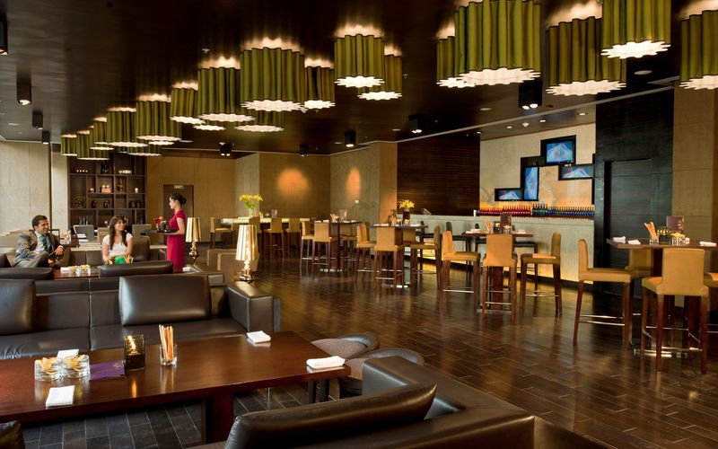
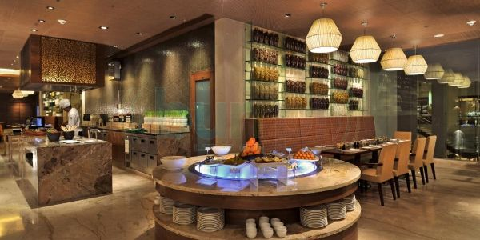
Hotels

Slide 9
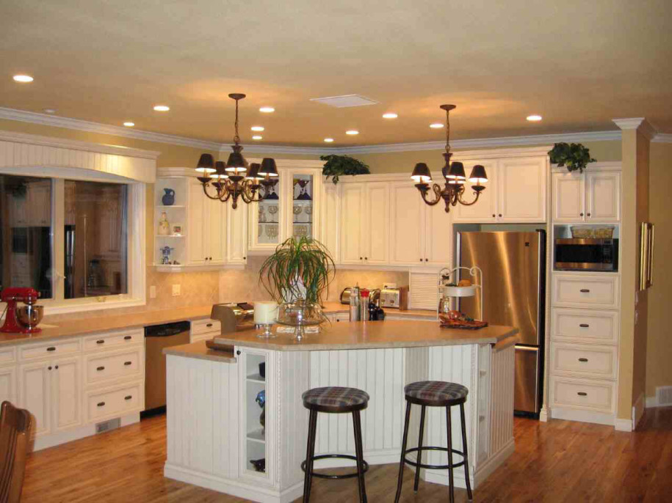
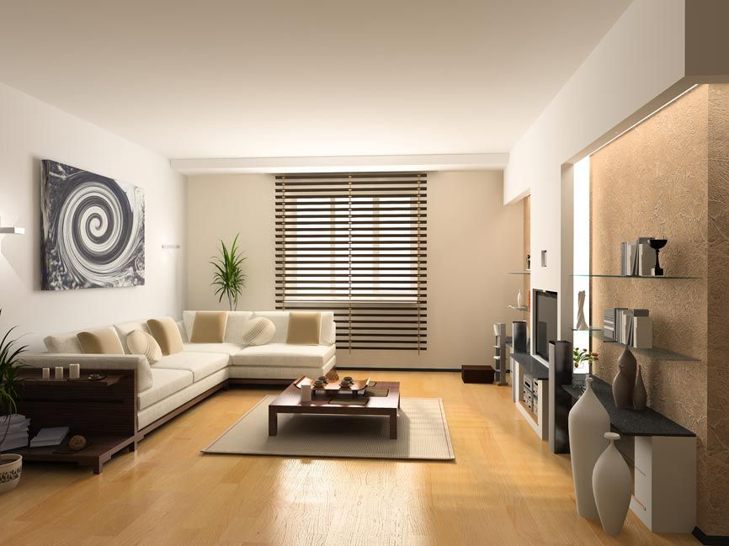
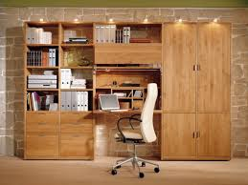
Home interiors

Slide 10
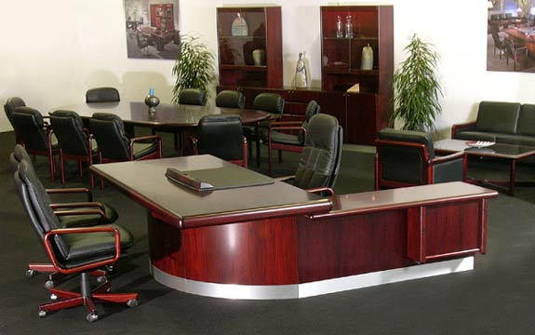
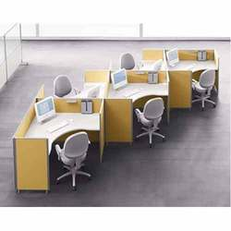
Office spaces

Slide 11
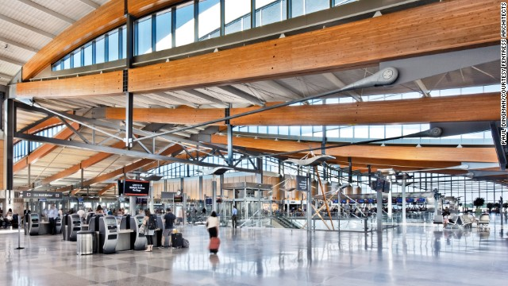
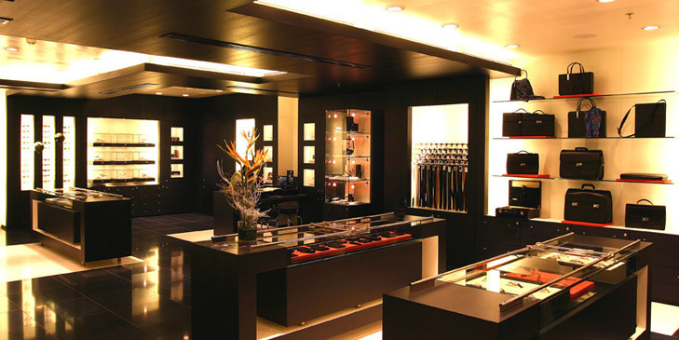
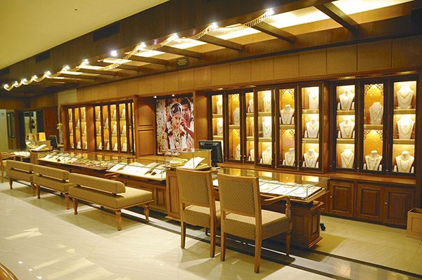
Commercial

Slide 12
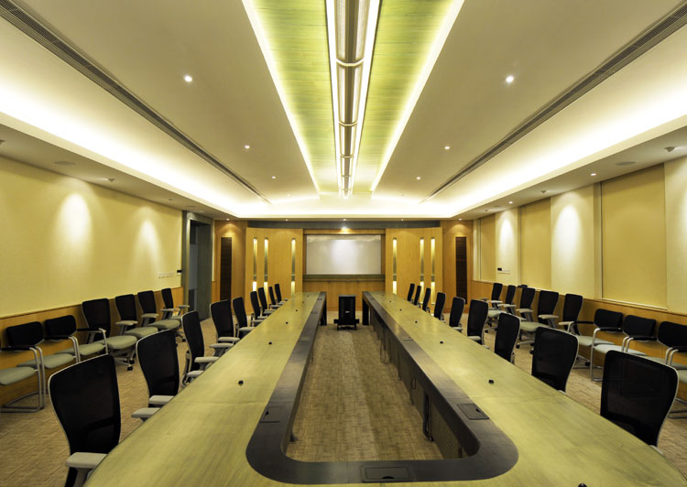
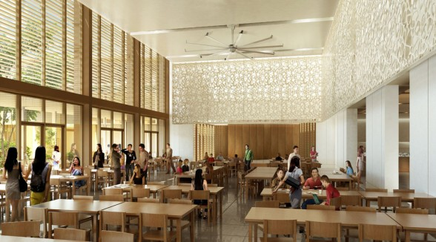
institutes

Slide 13
How to reach us
Want to know more about our services
or want to get associated,
CONTACT:
Asalam ali
Mobile No. : 9911178671 / 9810040889
E-mail : aslamali836@gmail.com
Office : 79-B, Ranaji Enclave, Nangli Dairy,
Nr: Dwarka More, New Delhi-110043

